Slide 1
If you’re happy and you know it...

Slide 2
What was your favorite nursery rhyme from last week?

Slide 3
If you’re happy and you know it...
Look at the child and make the following expressions(in the upcoming slides) with your face as you both look in a mirror. You can also use the camera on your phone. ( Just remember to flip the lens.)
Have fun! Take a picture of each expression.

Slide 4
Happy

Slide 5
Sad

Slide 6
Angry

Slide 7
Disgusted

Slide 8
Scared

Slide 9
Inside Out
https://www.youtube.com/watch?v=dOkyKyVFnSs

Slide 10
If You’re Happy and You Know It!
https://www.youtube.com/watch?v=71hqRT9U0wg

Slide 11
Family Activities

Slide 12
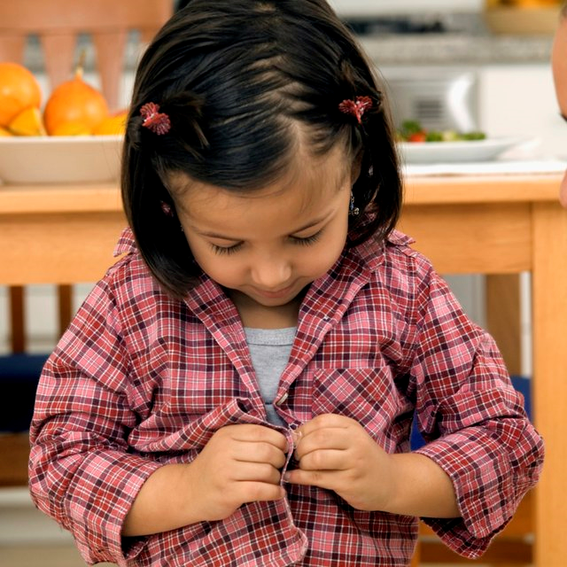
Dressing to the Music
For a fun time let’s see how the child is able to dress themselves without assistance. The goal is to see if the child is able to dress themselves successfully with enthusiasm.
Age group: Toddlers
Materials needed: ▪ Music ▪ Clothes (socks, shirt, pants, dress, etc.)
Step by Step:
Find a song that the child/children love.
Have the child/children’s clothes laid out.
Start the music. State to the child/children the item(s) of clothes to put on first.
Sing with them as they are putting on their clothes.
When they have completed getting dressed, do a celebration dance.
Enjoy.
For infants, play music as you dress them and watch their facial expressions.

Slide 13
We’re Going on a Shape Hunt
Mathematical skills are critical to children. When we introduce shapes and show connections to the items it must be done with excitement.
Materials needed: ▪ Items in the home that resemble shapes such as: square, circle, triangle, rectangle, etc.)
Step by Step:
Show or draw a picture of a shape.
Ask, “Can you find this shape in the house? “Let’s go on a shape hunt.”
When the child/children find a match, do a happy dance praising them for finding a match.
Continue to find other matches for shapes while on your hunt..
When they have completed the shape hunt, do a celebration dance.
Enjoy.

Slide 14
Table Talk
Mom/Dad, how are you doing?
Mom/Dad, do you know what school your child will be attending next school year?
Below is the link for Head Start and Early Head Start applications:
https://www.childplus.net/apply/en-us/B2855EBC0789C05E2CA908C3D052D221/28E9AAC9CDC89AF31E41FB50DF40D527

Slide 15
Additional Resources
https://www.youtube.com/watch?v=fN1Cyr0ZK9M
Hello, Hello can you clap your hands
www.pbs.com

Slide 16
References
YouTube:
https://www.youtube.com/watch?v=fN1Cyr0ZK9M
https://www.youtube.com/watch?v=71hqRT9U0wg
https://www.youtube.com/watch?v=dOkyKyVFnSs
Pee Dee Community Action Partnership. Enrollment Application link. https://www.childplus.net/apply/en-us/B2855EBC0789C05E2CA908C3D052D221/28E9AAC9CDC89AF31E41FB50DF40D527
Othandra Hicks. Family Activities
www.pbs.com

